Slide 1
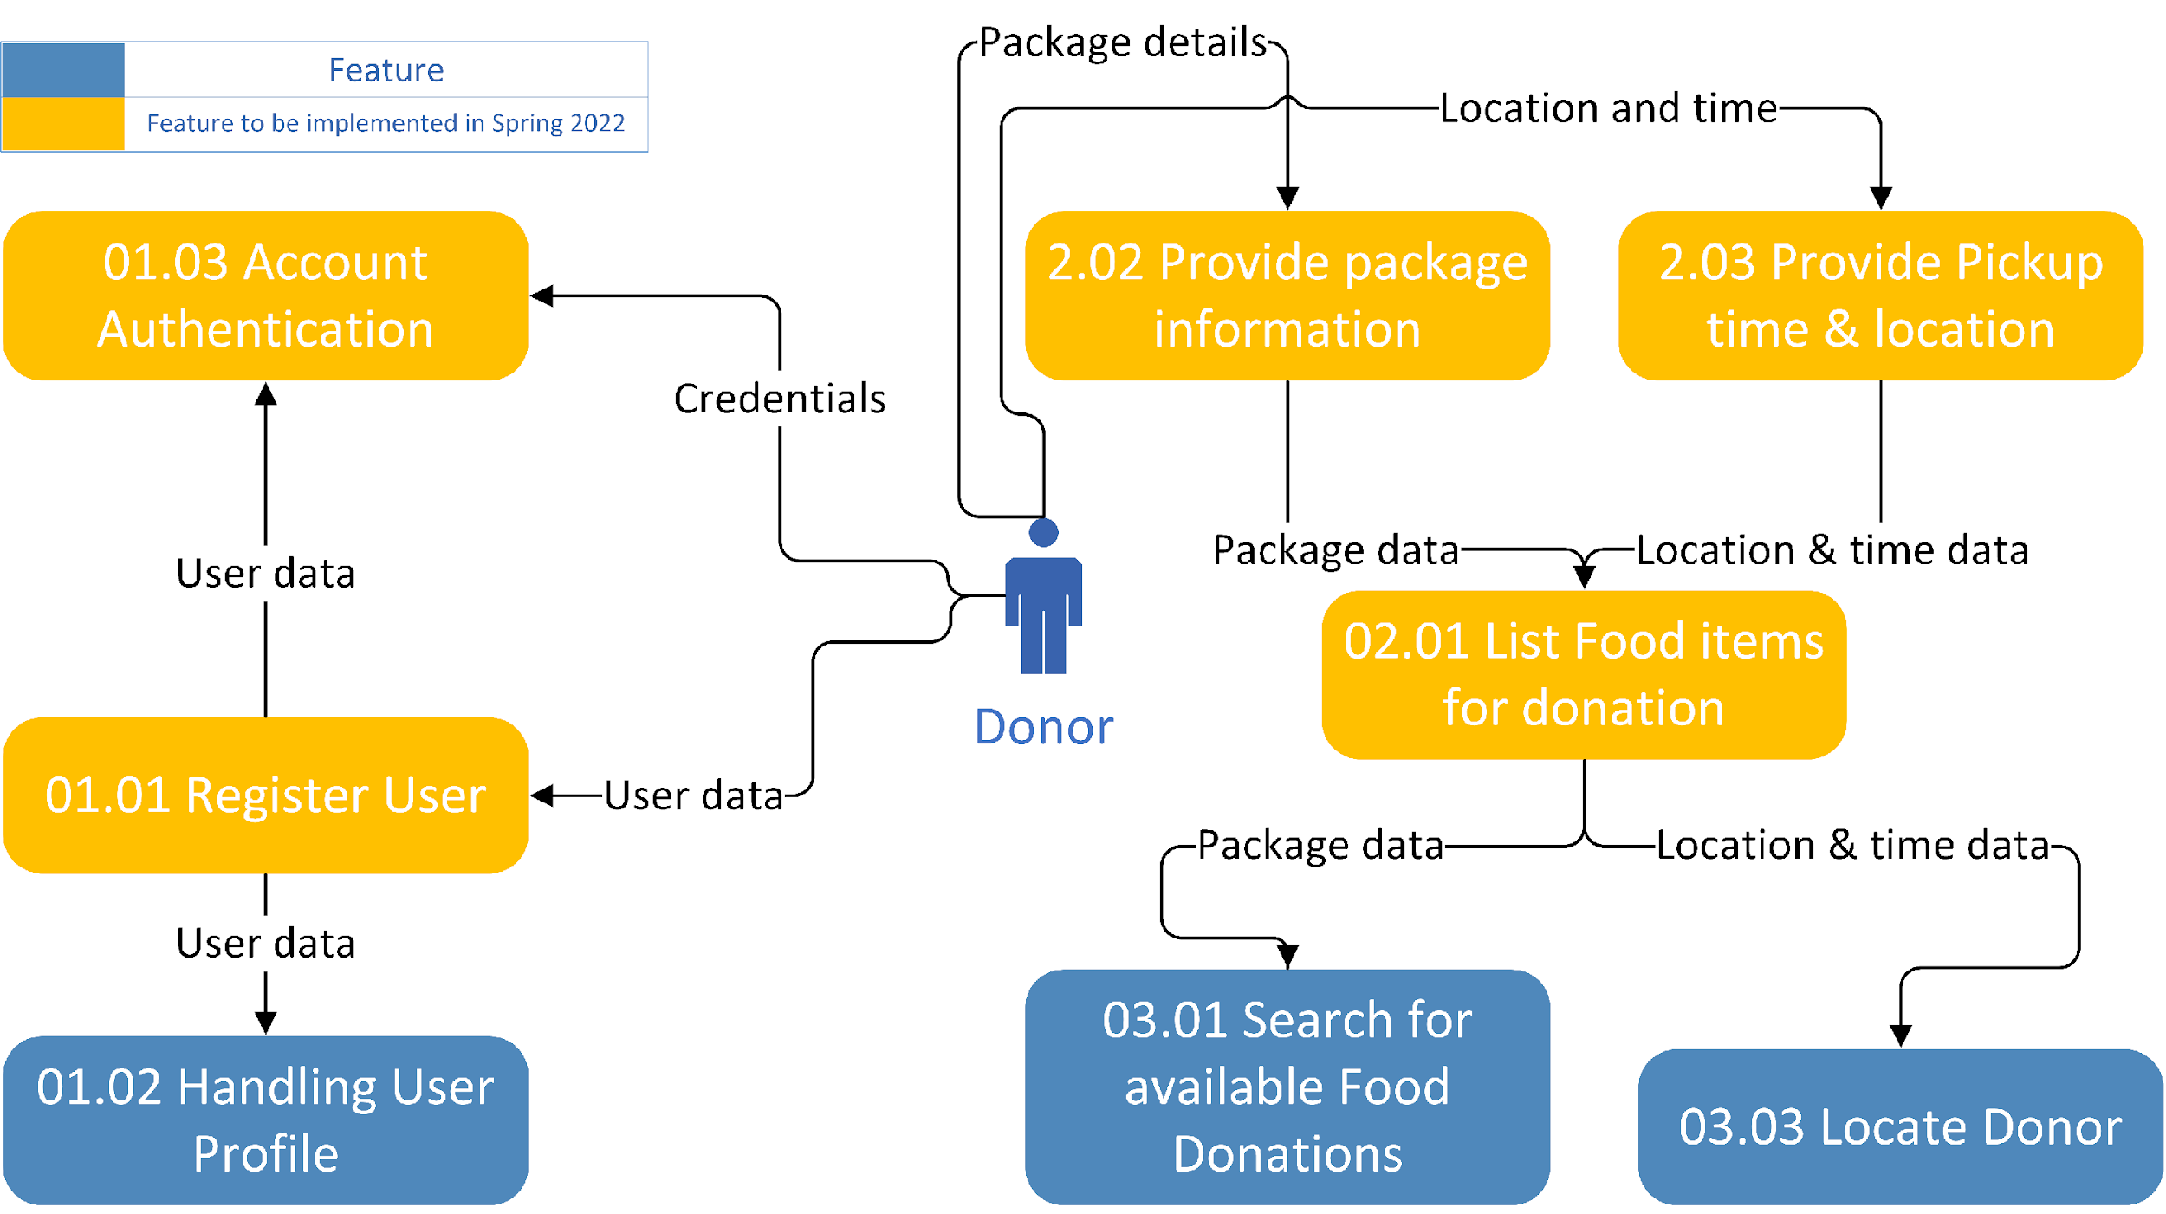
FoodPatry Data Flow Diagram(Logical)

Slide 2
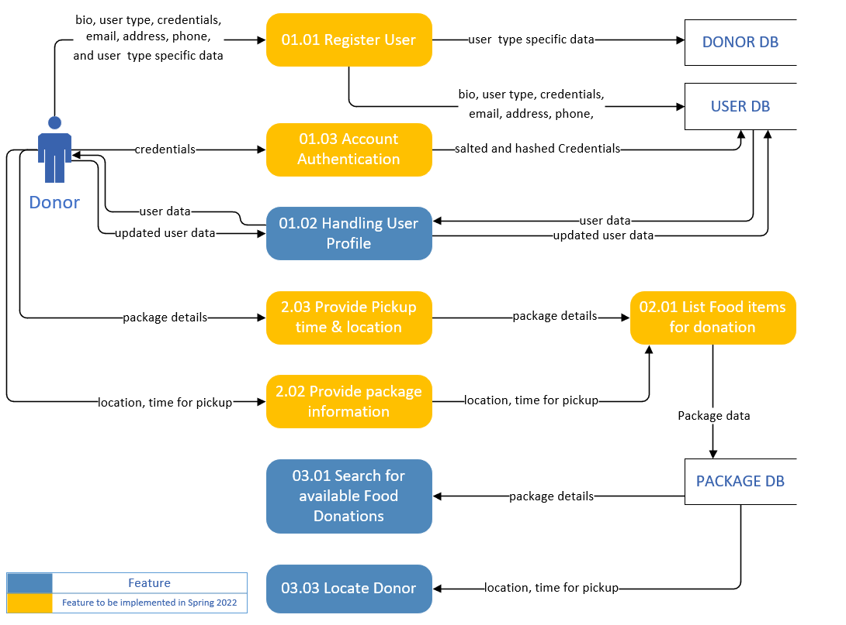
FoodPatry Data Flow Diagram(Physical)

